Slide 1
Balance Billing
Ashley Norse MD
Immediate Past President
Florida College of Emergency Physicians
October 15, 2015
Daniel F. Brennan MD
Chair, Medical Economics Committee
Florida College of Emergency Physicians

Slide 2
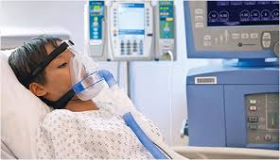
Patients Caught in the Middle

Slide 3
Extreme Variability in How Insurers Pay Out of Network
Payments all over the board:
0, 125, 150, 170, 200, 250, 325% Of Medicare allowables
Patient liable for balance bill
0%
Martin Gottlieb and Assoc., All FL OON payor data 4/2014 – 12/2014
Notes:
MGA All FL data 4/2014 – 12/2014
AVMED COVENT HUMANA CIGNA AETUS UNITED PREFEM PREMED
0% 1% 6% 6% 11% 34% 83% 79%

Slide 4
Emergency Physician Billing
$679
$372
$307
$49
Average Physician Out Of Network Charge
Average Insurance Payment
Average Patient Responsibility
Average Patient Payment
Insurance
Payment
Copay -
Co-insurance
Deductible
Balance Bill
≈$180
Patient Payment
Average Patient
Responsibility
MGA data
850,000 ED visits
July 2013-June2014
$686.07 = UCR
CPT 99283
80th%ile 336xx
Notes:
MGA data 850,000 ED visits
FAIRHealth TM UCR – GeoZip 336XX 99283

Slide 5
Balance Billing
A burden for patients
“Surprise” bill – expect ED coverage
Out Of Network + low payor payment = balance billing
A symptom of the inability of providers to contract for an adequate payment from insurers

Slide 6
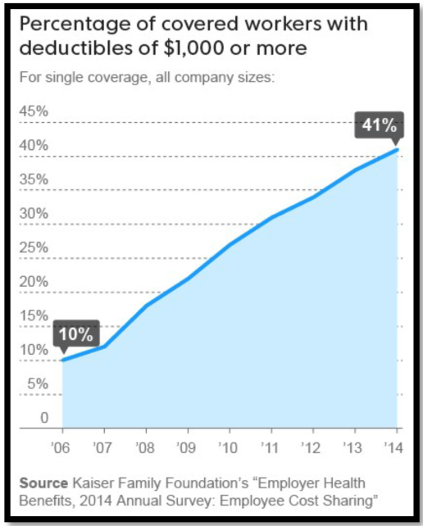
Balance Billing
Even without balance billing, patients (both in and out of network) often face large bills by insurance plan design
High copays designed to deter ED use
High deductible plans

Slide 7
Florida Emergency Medicine Volume Mix¹
FL has 3rd largest uninsured population
3,600,000 – Henry J Kaiser Family Foundation, CDC
Out Of Network =
Less than 4% of all FL ED visits
MEDICARE
23%
OON
12%
This 26% subsidizes
the other 74%
MCR/MKD/UNINS
Reimburse < cost of care
COMMERCIAL/
MANAGED CARE
26%
CONTRACTED
IN NETWORK
88%
MEDICAID30%
UNINSURED
20%
¹ MGA data, 850,000 FL ED visits, July2013 - June2014 OON 12% AHIP Feb2013
Notes:
Payor mix, MGA data July 2013-June 2014
OON 12%-- AHIP Feb 2013
Uninsured- exacerbated by lack of MKD expansion in FL (collect approx 3%)
MKD – low reimbursement in FL, about 60% of MCR- FL at bottom of US - (lowest 5 states)
MCR- see MCR vs CPI

Slide 8
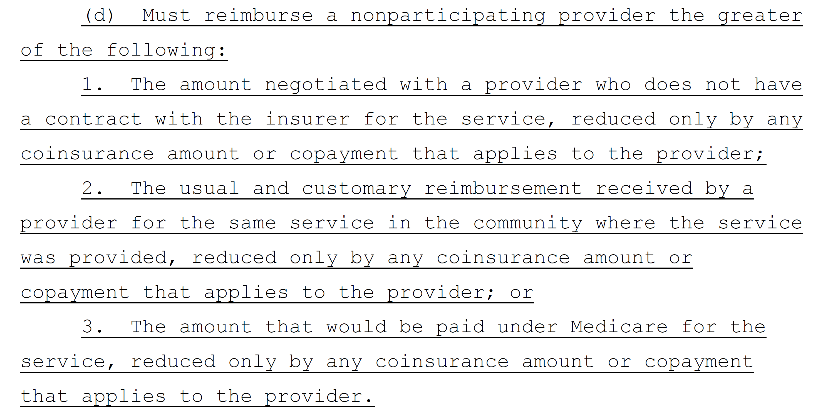
HB 221 (Trujillo) 2016 Similar to SB 516 Bean/Garcia / HB 681 Trujillo 2015
Balance Billing Ban
Also modifies existing HMO law
Compounds problems of last session’s proposals
Proposed OON Payment
Negotiated amount
Insurer’s UCR
Medicare
Notes:
Similar to SB 516 Bean / Garcia (2015) and HB 681 Trujillo (2015)
But also amends HMO law as per proposed PPO language

Slide 9
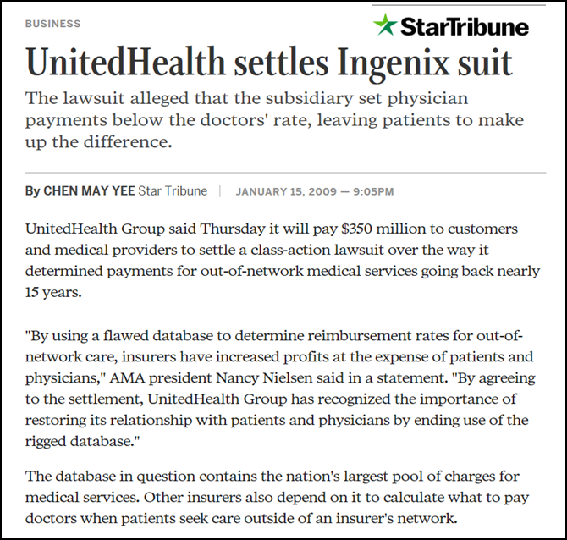
History of Insurers Manipulating “UCR” Payment Database
Ingenix Database
UHC
Aetna
Cigna
WellPoint
Underpaid providers
Patients left with balance bill

Slide 10
Medicare is Not a Reasonable Basis for Physician Reimbursement
Health Insurance CEO’s 2013
11 largest for-profit companies
Compensation packages $125 million plus
CPI – US All Item, US Dept of Labor Bureau of Labor Statistics http://data.bls.gov/ (+45% / 17 years)
Medicare Allowable, 99284, FL Loc 1 / 2, https://www.cms.gov and MGA data (+23% / 15 years)
Average Annual Family Health Insurance premiums http://www.ahrq.gov (+66% / 10 years)
Health Insurance CEO’s 2013 compensation – Center for Public Integrity http://www.publicintegrity.org 10/8/15
Notes:
10/6/15 Consumer Price Index - All Urban Consumers
Series Id: CUUR0000SA0 US all item Not Seasonally Adjusted Area: U.S. city average Item: All items Base Period: 1982-84=100

Slide 11
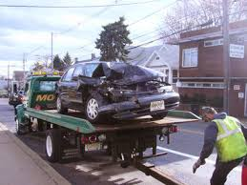
EPs seek FAIR Payment
Critical care 99291 1st hour $229.93
Medicare 2015 Allowable FL Loc 1 /2
Tow + inpound fee: $300 + mileage
Miami Dade

Slide 12
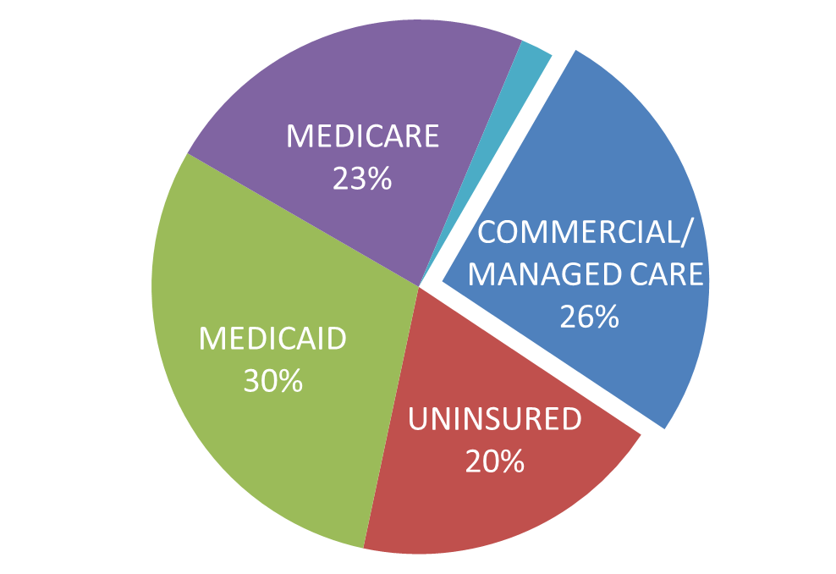
Unintended Consequences HB 221
Typical ED Payor Mix
Insurers fully control payment
No incentive to contract above Medicare
Even narrower networks
Providers and Access at risk
Medicare/Medicaid/Uninsured reimburse < cost of care
Gross revenue decreases 30-35% at Medicare rates¹
Net physician compensation drops by 50%
Community safety net placed at risk
^{1.} MGA / EPCF data, Managed care at Medicare rates vs. current contracts

Slide 13
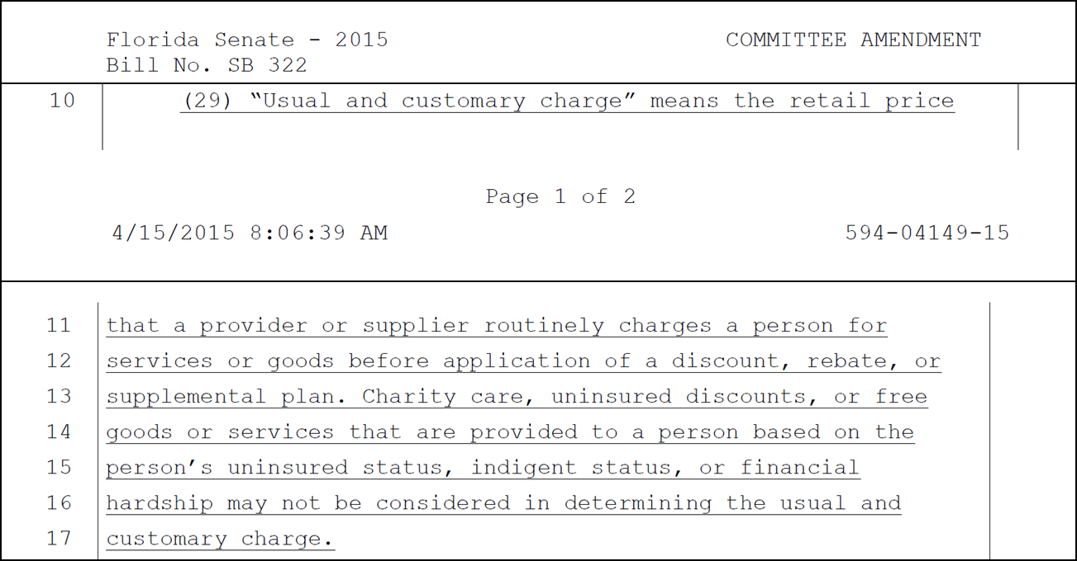
Problem #1 = HB 221 Payment Provisions
Solution – Define UCR required OON payment
Mimic HMO Law – “usual and customary charges”

Slide 14
Problem #2 Emergency Medicine CoPay /Co-Insurance & Deductibles
Unique to Emergency Medicine - EMTALA / patient advocacy
Emergency Physicians see all patients irrespective of ability to pay
Emergency Physicians are unable to collect copays / co-insurance or deductibles at point of service
Solution
Insurers “front the money”
Insurers directly reimburse ED providers
Insurers collect co-pays, co-insurance and deductibles from subscribers according to their plan design

Slide 15
Problem #3 – Dispute Resolution
MAXIMUS
Rarely used (9 claims accepted for review in 2014)
Viewed by providers as unreliable, arbitrary
Solution:
Standard dispute resolution procedures
Arbitration – ie AAA
Legal recourse
Prevailing insured or beneficiary costs recoverable (e.g., F.S 627.428)

Slide 16
EPs are Patient Advocates 24/7/365 Seek FAIR Payment to Maintain Access to Care With FAIR Payment No Balance Billing Occurs
Notes:
FAIR Payment – necessary to maintain safety net; access to care

